Slide 1

Facial Expression Detection

Slide 2
Introduction
Datasets
Models
Hardware
Improvements

Slide 3
Datasets

Slide 4
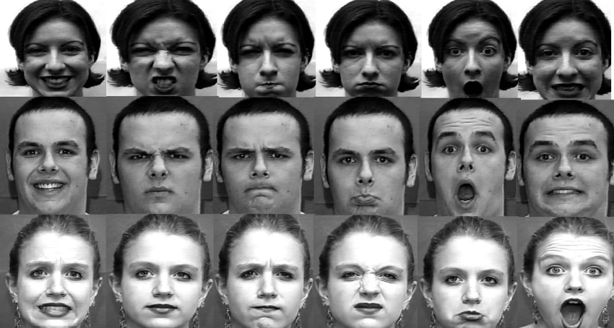
Datasets: Cohn Kanade CK+
593 video sequences from 123 subjects, each video consists of 10-60 frames.
It shows a shift from neutral expression to peak expression.
327 sequences are labeled with the seven basic expressions.
Color: gray

Slide 5
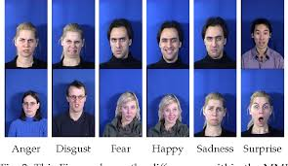
Datasets: MMI
1280 sequences and 250 images from 43 subjects.
213 sequences are labeled with the six basic expressions
MMI has more challenging conditions than CK+, i.e., there are large inter-personal variations because subjects perform the same expression non-uniformly and many of them wear accessories (e.g., glasses, mustache)
Color : Colored

Slide 6
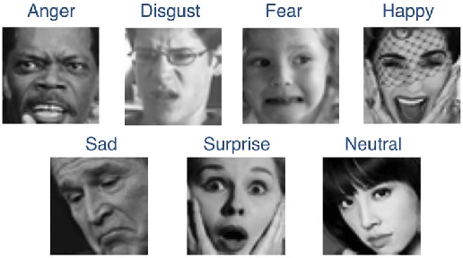
Datasets: FER2013
28,709 samples for training, 3589 samples for validation.
48*48 grayscale images labeled with the six basic expressions.

Slide 7
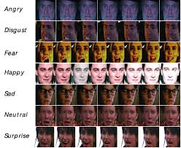
Datasets: AFEW
1809 videos (773 Training, 383 validation, 653 test) labeled with the seven basic expressions.
Collected from movies with spontaneous expressions, various head poses and illuminations.

Slide 8
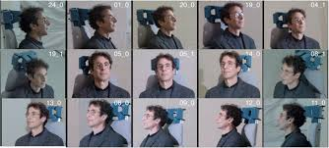
Datasets: Multi-Pie
755,370 images from 337 subjects under 15 viewpoints and 19 illumination conditions labeled with the six basic expressions.

Slide 9
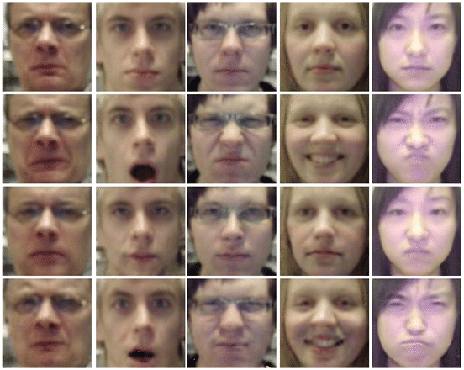
Datasets: Oulu CASIA
2,880 image sequences collected from 80 subjects labeled with six basic expressions.
Captured with near infrared or visible light.

Slide 10
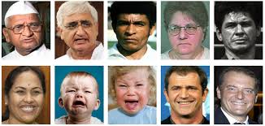
Datasets: EmotioNet
One million images labeled with 23 basic and compound expressions

Slide 11
Models

Slide 12
Models: MiniXception
Concept:
Removal of fully connected layers
Depthwise Seperable convolution breaks us in two parts:
Depthwise convolution: filtering stage
Pointwise convolution: combination stage
Complete pipeline: OpenCV face detection module -> the gender classification -> emotion classification.
Takes 0.22 ± 0.0003 ms on a i5-4210M CPU

Slide 13
Models: MiniXception
Advantages:
Number of Parameters = 60,000 (10 times less than Xception)
Takes 0.22 ± 0.0003 ms on a i5-4210M CPU.
66% accuracy on FER2013 dataset
Disadvantages:
The use of glasses might affect gender classification and emotion classification.
Reference:
https://arxiv.org/pdf/1710.07557.pdf

Slide 14
Models: MicroExpNet
This model is aimed at creating extremely small and fast convolutional neural networks (CNN) for the problem of facial expression recognition (FER).
Experiments are made on two widely used FER datasets, CK+ and Oulu-CASIA. Our smallest model (MicroExpNet), obtained using knowledge distillation.

Slide 15
Models: MicroExpNet
Facial Expression Recognition As:
Image-based.
Sequence-based.
Advantages:
less than 1MB in size
works at 1851 frames per second on an Intel i7 CPU.
Disadvantages:
less accurate than the state-of-the-art.
Frontal Face Images

Slide 16
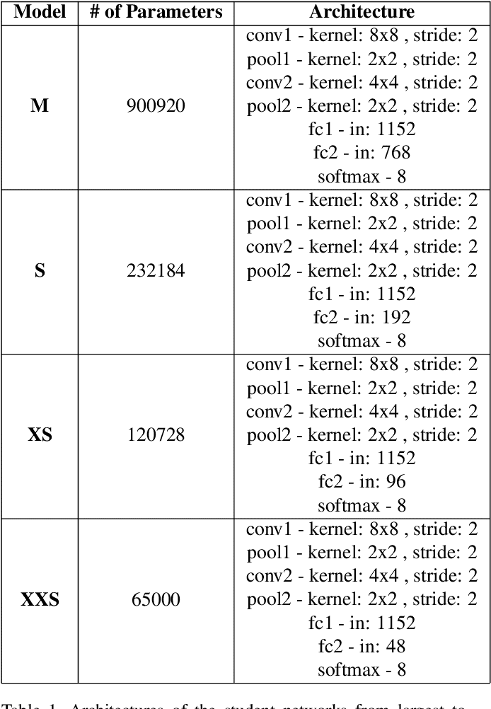
Models: MicroExpNet

Slide 17
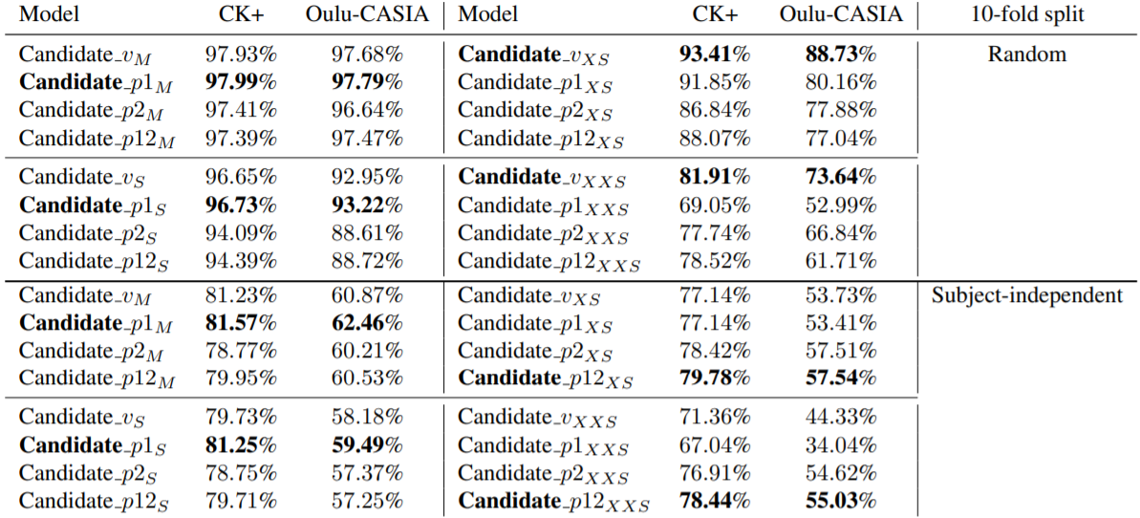
Models: MicroExpNet
The effect of max-pooling. Classification performances of the candidate models for 1000 epochs of training. p1 indicates that there is only one max pooling layer after conv1, p2 indicates that there is only one max pooling layer after conv2, p12 indicates that each conv layer is followed by a max pooling layer, and v indicates that there is no pooling layer at all. The smaller the network, the more max-pooling degrades the performance for random split whereas the opposite holds for subject-independent split.

Slide 18
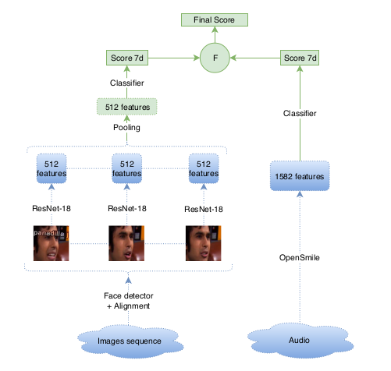
https://arxiv.org/pdf/1808.02668.pdf
Models: Occam’s Razor View

Slide 19
Architecture
Models: Occam’s Razor View
This paper presents a light-weight and accurate deep neural model for audiovisual emotion recognition. The authors followed a philosophy of simplicity, drastically limiting the number of parameters to learn from the target datasets, always choosing the simplest learning methods.
The flow of the model is as follows:
Learn still image emotion classifier using ResNet-18.
Replace last dense layer of ResNet with two dense layers: one arousal-valence linear regressor and one emotion classifier (softmax layer). Optimization leads to a more general 512-sized hidden representation.
Obtain L (number of frames in sequence) 512-dimensional face descriptors with their associated scores (one score for each one of the seven categories) as well as arousal/valence predictions.
Select n faces with highest scores from L original ones.
Apply temporal pooling of the n face features.
Get prediction using softmax layer.

Slide 20
Models: Occam’s Razor View
Advantages
high accuracy (60.6% on AFEW’s test set).
Lightweight (180 Million FLOPS).
Addresses the problem of small training set.
Apply its concepts (e.g.: simplicity, temporal features extraction) on more sophisticated models that have higher accuracy.

Slide 21
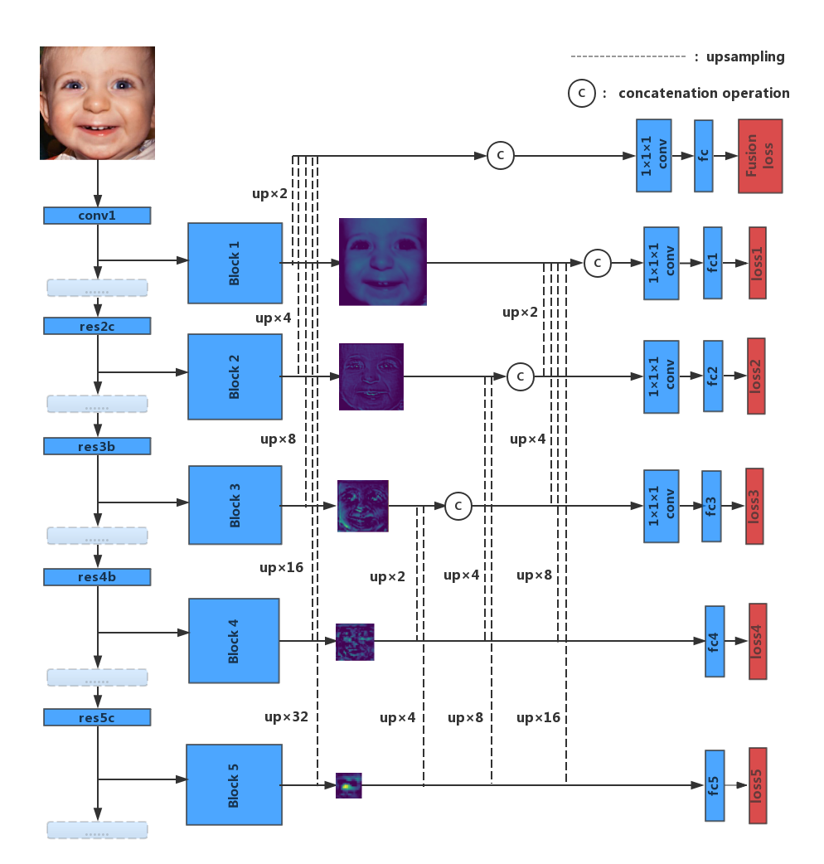
Models: Deeply-Supervised
In this paper a novel ensemble method is proposed that utilizes both deep but semantic and shallow but high-resolution information to provide a more comprehensive representation of features and achieve a better performance.
https://www.researchgate.net/publication/328036791_Video-based_Emotion_Recognition_Using_Deeply-Supervised_Neural_Networks

Slide 22
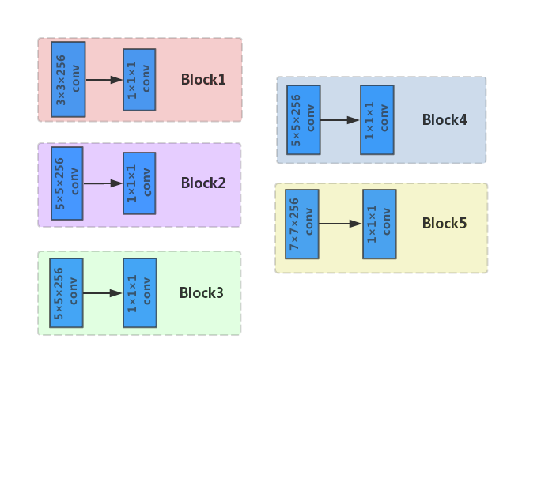
Models: Deeply-Supervised

Slide 23
Models: Deeply-Supervised
The goal of the proposed deeply-supervised CNN is to enrich the feature map of each layer, by combining the connections across the side-output layers. To this end, de-convolution techniques are adopted in the upsampling operation depicted in previous figure, which can take input of an arbitrary size and produce correspondingly size output.

Slide 24
Models: Deeply-Supervised
Advantages
Disadvantages
High accuracy: (61% on AFEW test set).
The deeply-supervised could be applied on other architectures.
Moderate complexity.
May require strong hardware to be able to work in real-time.

Slide 25
Models: MobilNetV2
This Model focuses on using multiple enhancements on already developed architectures such as MobileNet and RTNN.
Spatial transformer layer
Sobel and Laplacian operators
Global average pooling and DepthSep layers
Depthwise separable convolution (DepSep)

Slide 26
Models: MobilNet V2
Advantages:
Proposed architecture is fast, lightweight (650k parameters) and accurate (83% on FER+ test-set).
The Suggested framework increases any model's accuracy from 3% to 5%.

Slide 27
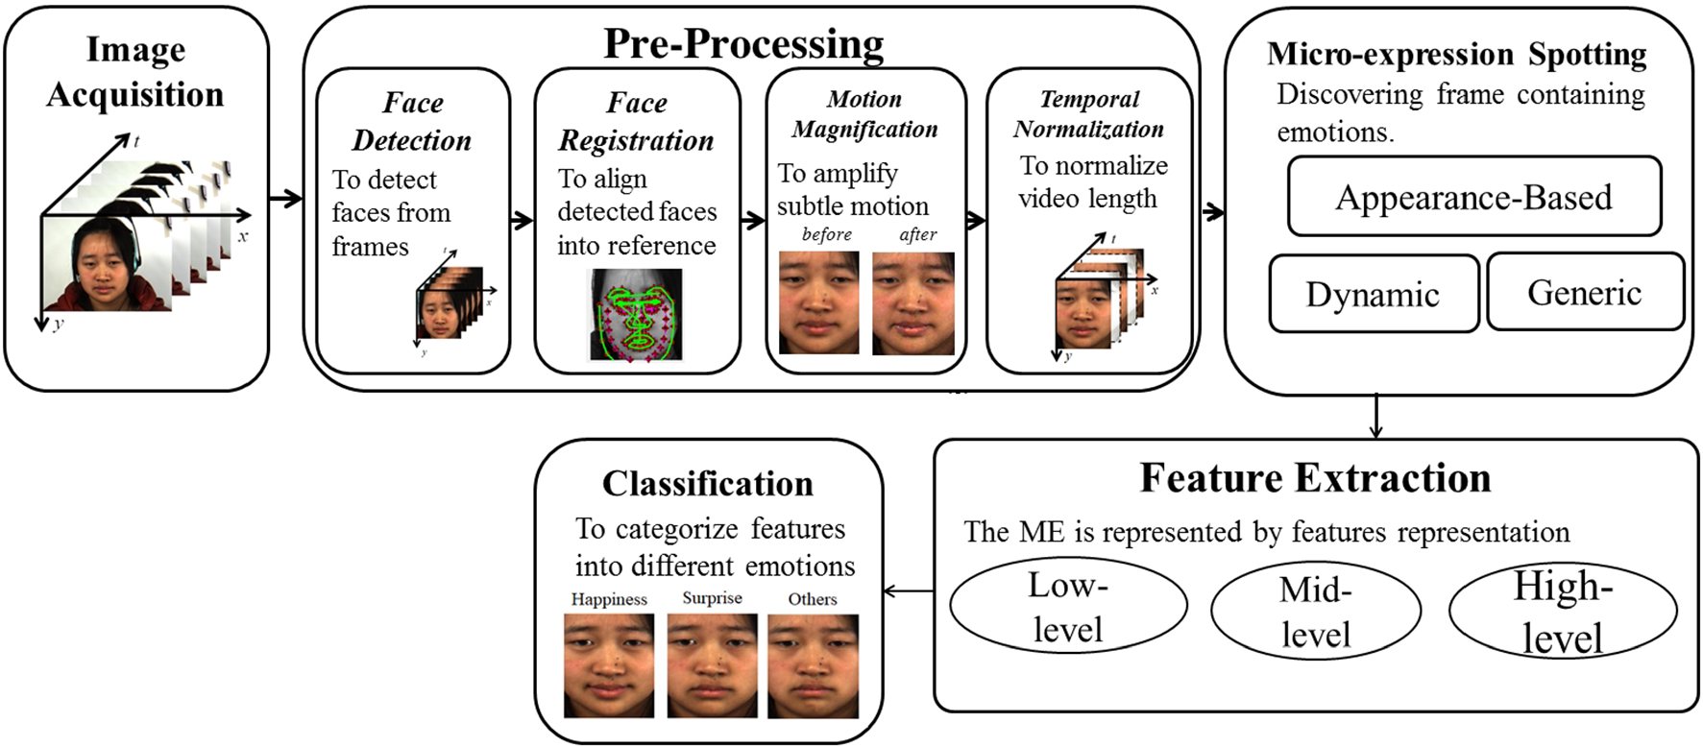
Emotion Recognition Pipeline
Models: Frame Attention

Slide 28
What is attention mechanism?
Models: Frame Attention
human vision is that of attention, i.e. the process by which we focus the computational resources of our brain's visual system to specific regions of the visual field
we can then ignore irrelevant visual information by intelligently exploring the visual field
http://www.dmi.usherb.ca/~larocheh/projects_attention.html
https://arxiv.org/ftp/arxiv/papers/1901/1901.10042.pdf

Slide 29
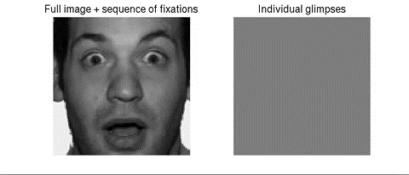
Attention Mechanism For Emotion Recognition
Models: Frame Attention

Slide 30
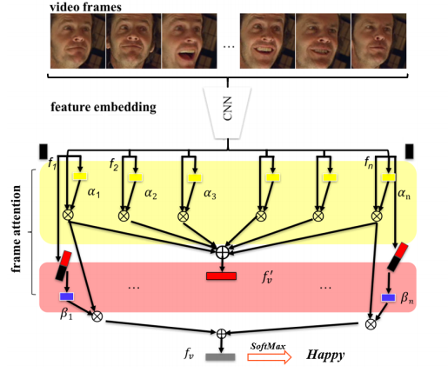
Model Structure
Models: Frame Attention
The whole network is composed of two modules.
The feature embedding module is a deep Convolutional Neural Network (CNN) which embeds face images into feature vectors.
The frame attention module learns multiple attention weights which are used to adaptively aggregate the feature vectors to form a single discriminative video representation
https://arxiv.org/pdf/1907.00193v2.pdf

Slide 31
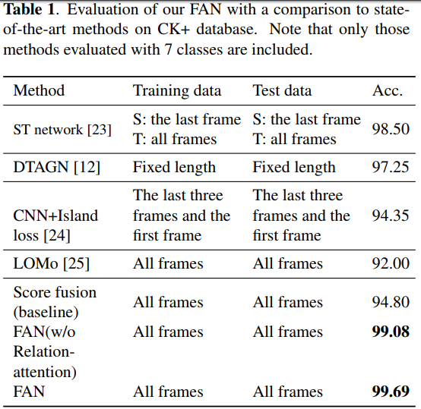
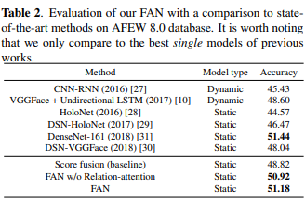
Evaluation On CK+ Database
Models: Frame Attention
Evaluation On AFEW Database

Slide 32
Advantages
Models: Frame Attention
achieved performance on par with that of state-of-the-art methods on AFEW and obtains state-of-the-art results on CK+.
Attention mechanism enables networks with less than 10 layers to compete with (and even outperform) much deeper networks for emotion recognition
Uses ResNet-18 CNN which achieves high performance for real time applications with number of parameters in range of 4.5:11 million parameters
https://arxiv.org/pdf/1902.01019.pdf

Slide 33
Hardware kits

Slide 34
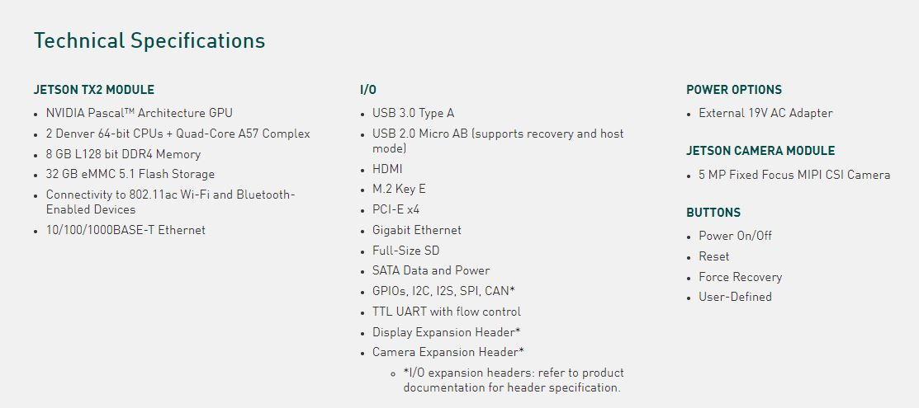
Nvidia JetsonTx2 Developer kit
Specifications

Slide 35
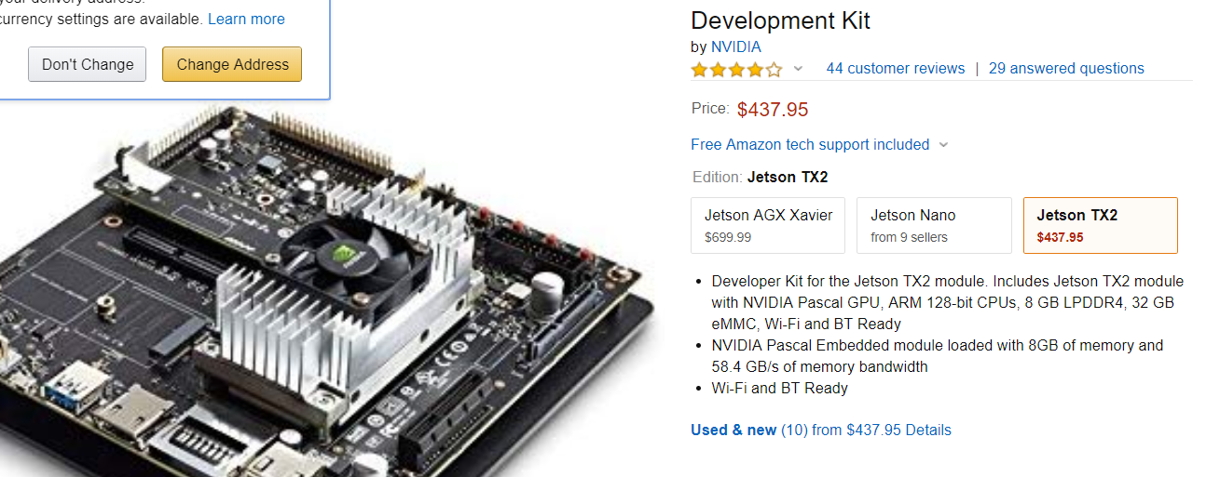
Nvidia JetsonTx2 Developer kit
Price on Amazon

Slide 36
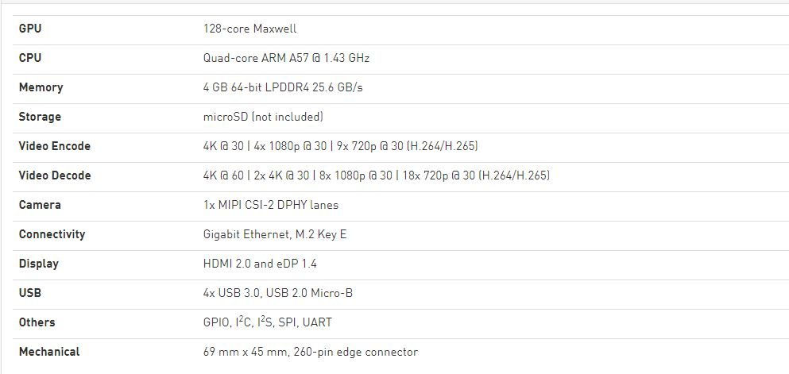
Specifications
Nvidia Jetson Nano Developer kit

Slide 37
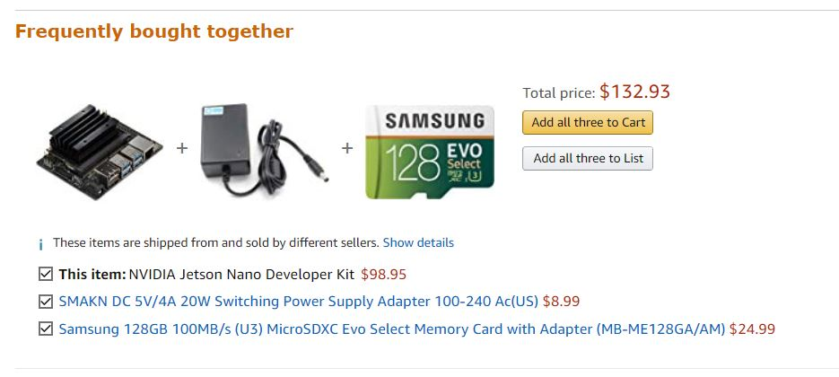
Nvidia Jetson Nano Developer kit
Price on Amazon

Slide 38
TPU
Tensor processing unit was announced in May 2016 at Google I/O,
The chip has been specifically designed for Google's TensorFlow framework.

Slide 39
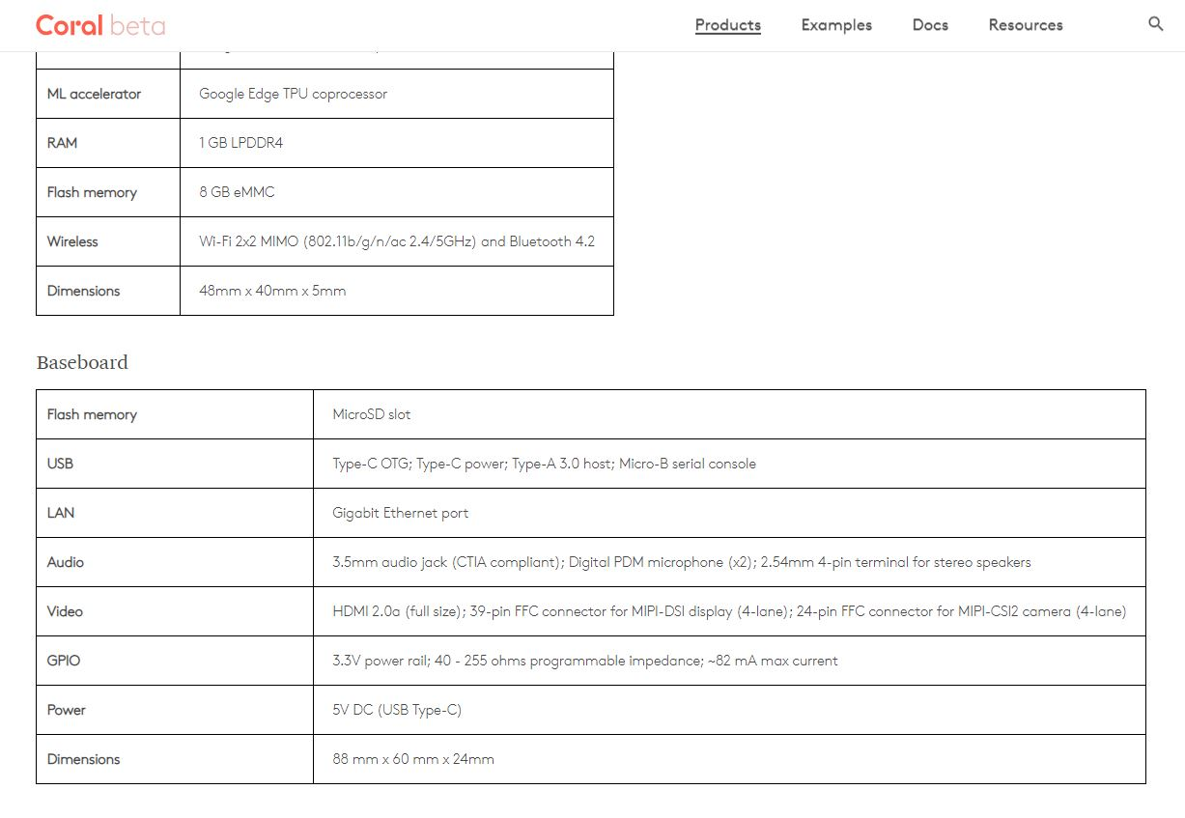
Specifications
Coral dev board

Slide 40

Price
Coral dev board

Slide 41
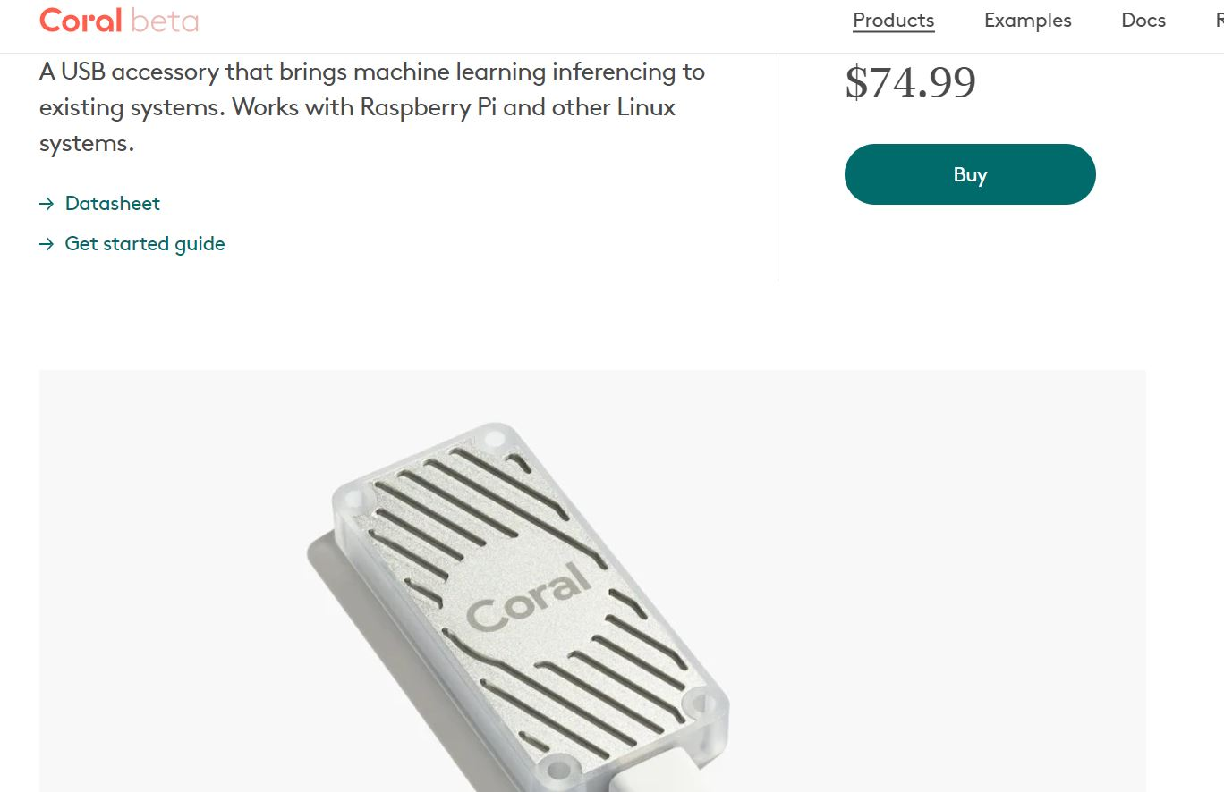
Coral Accelerator
The Coral USB Accelerator is a USB device that provides an Edge TPU as a coprocessor for your computer.
It accelerates inferencing for your machine learning models when attached to a Linux host computer.

Slide 42
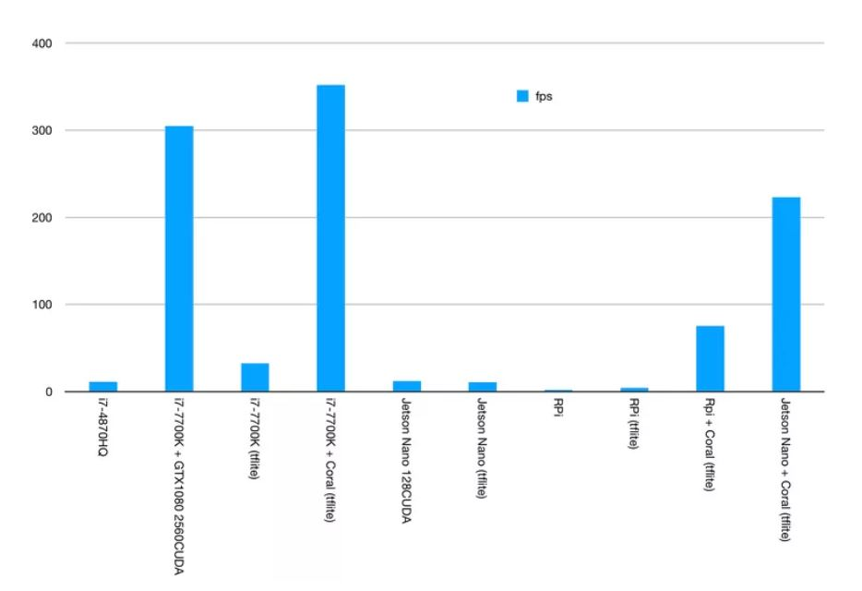
Important benchmarks

Slide 43
Improvements

Slide 44
Improvements
Use transfer learning
Use Google’s Morph-Net to reduce network size
Datasets Migration
Dropping layers related to other non-used emotion labels.

Slide 45
Conclusion

Slide 46
Thank you

